Slide 1
Guinea Dog
By Patrick Jennings

Slide 6
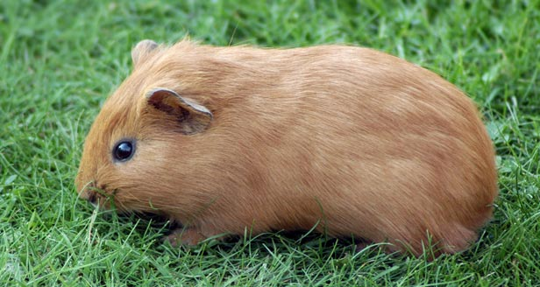

Slide 9
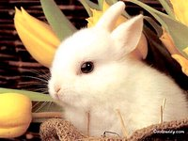

Slide 10
