Slide 1
The Blackthorn Key
By Noah Ross

Slide 2
DARK AND MYSTERIOS

Slide 3
THE GREATEST

Slide 4
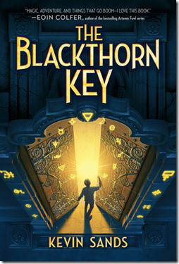

Slide 5
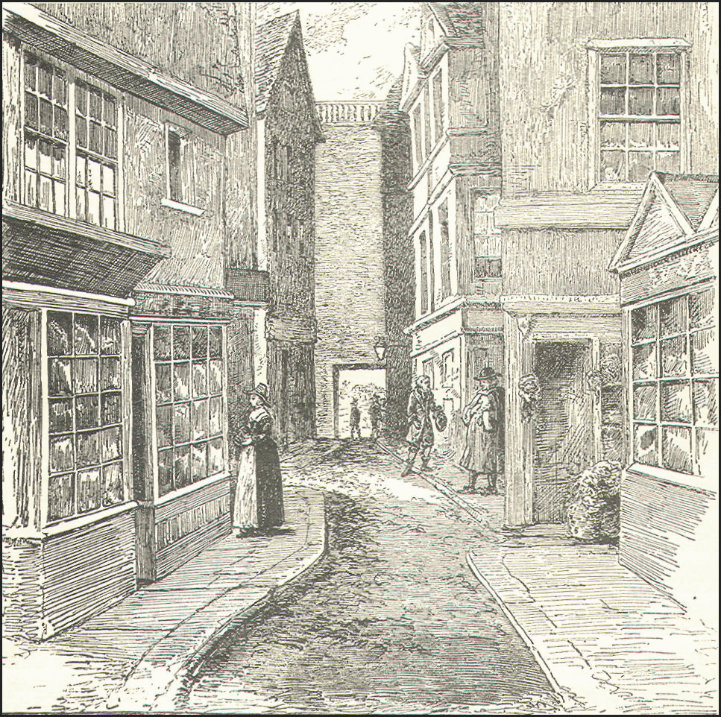
Christopher Rowe
1665
Master Benedict Blackthorn

Slide 6
Work time

Slide 7
Recipes and Remedies that heal.
APOTHOCARY

Slide 8
Latin

Slide 9
Deadly or Helpful

Slide 10
Cure to asthma
Madapple Tea
3 seeds=cured
6 seeds=great pain
10 seeds=dead

Slide 11
Acid that Burns
Oil of Vitriol
Burns through anything

Slide 12
Give it to me!

Slide 13
They’ll do anything

Slide 14
All mine!
Power

Slide 15
I got you now

Slide 16
Best part
#Got you now

Slide 17
Don’t stop believing
No matter what happens

Slide 18
Codes to decipher, riddles to be solved, all leading up to one important puzzle.
Why The Blackthorn Key?
I think I know.

Slide 19
Mark of the Plague
Coming Soon 9/6/16

Slide 20
THE BLACKTHORN KEY #favbookever

Slide 21
Credits
Music
“Blue Valleys”
Composer: Noah Ross
Trumpet Player: Noah Ross
Project
Creator: Noah Ross
Presenter: Noah Ross
Special Thanks
Computer: Sara Ross
Music help: Josh & Sara Ross
Audience: 5M

